Slide 1
Test Sage – Dhruv’s AI Powered Test Automation Platform

Slide 2
AI Powered Software Testing - Context
Integration of AI in the software testing process is prevalent and represents a paradigm shift in quality assurance, offering numerous benefits over traditional methods
AI techniques and algorithms streamline processes, reduce human intervention, and contribute to a faster, more reliable software development cycle
The purpose of using AI in Software Testing is not to automate tedious tasks but to:
Automate repetitive tasks
Predict and solve complex defects such as code changes, historical defect data, and other relevant factors to understand potential issues and areas of the software.
Generate adaptive test cases based on requirements, specifications, and historical data
Log analysis analyzes log files and other system data to identify patterns and issues.
Use behavior simulation to imitate user interactions to uncover usability issues, performance bottlenecks, and other problems.

Slide 3
Test Sage – Dhruv’s AI Powered Test Automation Platform
Advanced Automations
Script less Automation
Data driven, Reusables,Conditions,Assertions
05
01
Automations created using Plain English statements(Test Sage grammar)/keywords.
Parallel Execution
AI powered Automation
On the fly environment creation for parallel execution, browser compatibility testing
06
02
Automations generated on the fly from well documented manual test cases.
Single effort to create both Manual and Automation Test Cases
Extensive Test Results
High level and detail reporting – Screen shots and videos capture
07
03
Test steps written using Test Sage grammar creates both manual and automation test cases.
Single platform for all automation needs
AI assisted maintenance
08
04
Smart self-healing of script failures due to application changes, exceptions.
Web, Mobile and API Testing.

Slide 4
Challenges and Our Solution
Automation Challenges
TEST SAGE Solution
Outcome
Double effort to create Manual and Automation test cases
One time effort to create both Manual and Automation test steps
Test case development effort reduced by 70%-80%
Huge Automation backlog - Not in line with feature delivery
No automation backlog- Single effort to create both Manual and Automation Test cases
In-Sprint Automation
High maintenance effort due to application changes
AI Assisted Auto Script healing capabilities
Maintenance effort reduced by 60%-70%
Low ROI due to execution and result analysis over head
AI Assisted failure analysis and auto correction, On the fly execution infra creation
High ROI due to low development and maintenance effort

Slide 5
Use Case# 1
Automation of 1000 Regression Test Cases
# | Activity | Open-source Tools (Selenium/Appium) | Test Sage
1 | Framework set up effort (Person days) | 15 | 0
2 | Automation of Test cases | 334 3 Test Cases per day | 100 10 Test Cases per day 3X Productivity Improvement
3 | Effort Saved (Person days) |  | 224 person days
4 | Resource Type | Skilled Expensive resources | Manual QA Resources 60%-70% Cost Saving
Key Differentiators:
Script less Automation - No coding needed. Manual QA engineers with no coding/programming skills can automate
Simple English Language – Automation Test cases are documented using simple English statements

Slide 6
Use Case# 2
Maintenance and Execution of 1000 Regression Test Cases
# | Activity | Open-source Tools (Selenium/Appium) | Test Sage
1 | Maintenance Effort - Script update due to application changes | High Maintenance Effort as it is script based | Low maintenance effort due to Smart Automation (60-70% Less)
2 | Result failure analysis | High effort for test script failure analysis as it is code based | Minimum effort due to Smart Result Analysis and Auto Healing (60-70% Less)
3 | Cost Saving |  | 60-70% Cost Saving
Key Differentiators:
Smart Automation - Impact of UI changes on scripts managed easily with Plug In
Auto Healing – Automated correction of scripts for certain failures (UI)
Smart Result Analysis – Analysis of failed test cases and auto suggestion for correction

Slide 7
Key Differentiators of Test Sage Summarized
Reduced Effort in Test Case Development - Manual and Automation test cases developed together - resulting in reduction oof effort by 70% - 80%
In-Sprint automation - No separate backlog for automation
Auto Healing - AI assisted auto script healing capabilities reducing maintenance effort by 60% - 70%
Improved Productivity (compared to other open-source tools) - Three times better productivity in automation of test cases - (10 test cases per day versus 3 test cases per day with other tools)
Scriptless automation – No programming/coding skills needed - resulting in estimated cost reduction by 60% - 70%
Simple English Language - Automation Test cases are documented using simple English statements
Smart Automation - Impact of UI changes on scripts managed easily with Plug-Ins
Smart Result Analysis – Analysis of failed test cases and auto suggestion for correction

Slide 8
Test Sage – backed by Experience/Credentials
Test Sage – Dhruv’s AI-Powered Testing Platform
Applicability: Works for any web-based application
Dev. Team: 40+ engineers (and scaling) trained and using it across projects
Implemented: for 10+ Projects across domains
Deployment Model: As-a-Service; Licensed; On-Prem; Cloud
Technology: JavaScript Stack – Angular, NodeJS, MongoDB, ML Libraries

Slide 9
Opcenter Test Automation - Approach
Generic Test Scenarios representing workflows and transactions are documented
Test Scenarios are already Automated and ready to use
Workflow level, Transaction level and Screen level customizations need to be incorporated
Identify the Work Flows to Automate(Smoke, Regression)
Dhruv Opcenter Generic Semi-Suite Test Repository
Reuse the existing Test Repository
Customize as per the need
Smart Execution and Reporting – Integrate with CI/CD

Slide 10
Opcenter Test Automation - Comparison
Traditional Approach
Dhruv Test Platform
Document Priority Regression Test Scenarios
Automate by reusing existing Test Repository
Automate Test Scenarios using Open Source/Licensed tools
Update the test steps as per customization
Execute and Maintain
AI based Execution and Maintenance
# | Activity | Traditional Approach | Dhruv Test Platform | Effort Saving
1 | Regression Test Automation | X | X * 0.3 | 70%
2 | Execution & Maintenance | Y | Y * 0.5 | 50%

Slide 11
Why Dhruv?
Opcenter MES Veterans with over 18 years of experience in End-to-End Implementations, Upgrades / Migrations, Enhancement Engagements and in Validation and Delivery Support Engagements.
No “Paper on Glass” methodologies.
Focused on Value Realization through industry standards and best practices.
Provide Global Strategic Deployment Best Practices to enable a global template driving process and technical harmonization.
End to End Services – Enablement to Adoption to Hypercare to long term AMS.
Competitive Cost Structure and Customer enablement with
proven and efficient Onshore-Offshore Design and Delivery model.
11

Slide 12
Purpose
A Health Care Product Start up company Partners with
OPAL to implement Continuous Testing to achieve following key objectives
Reduce defects in production
Reduce Test effort from 4 Weeks to 2 days
Reduce Test cycle time from 1 Week to 2 days
12

Slide 13
Business Needs
Customer is a Product Start up company in Health care domain. They are in the process of implementing next gen solution for Health care providers in the US region.
Product is operational and many customers are using the software to meet their day to day business and operational needs. As per customer/market feedback, new features and enhancements are being planned/delivered in an incremental fashion. While the new features were being delivered, due to limitation with the existing Testing effort, quality of the releases were compromised and lots of defects were leaked to production resulting very low customer confidence on the new releases.
As more effort was spent in testing application manually, it was difficult to test all features of application before release resulting in defects slippage.
There was need to improve overall approach towards Testing, reduce overall Test Effort/Time and at the same time improve the test coverage.
13

Slide 14
Findings
Based on the analysis of the current Test implementation following were the gaps/limitations observed.
Test cases were not optimized resulting in redundant/duplicate/incomplete test cases
Test automation framework was not properly implemented due to which it was not scalable
70% of the Regression Test cases were still executed manually due to limited Skilled Test Automation Engineers availability
Most of the priority defects were either missed or detected very late in the test cycle
Configuration changes in Test and Production environment gaps resulted in many scenarios not being Tested in Testing Phase
Non functional tests mainly Performance and Security Tests were not planned regularly. This was the reason for some of the non functional defects raised in production like slow response times, application crash
14

Slide 15
The Solution
Improved overall testing process by adapting Agile Testing best practices. Key implementation steps are
Optimized the regression suite
Formalized the approach and template for new test case authoring with objective to achieve maximum coverage with optimal no of test cases
Re designed the Test Automation Approach. Integrated AI – Test Platform.
Implemented Automation framework and approach
Stream lined the Test data management approach
Achieved parallel execution and cross platform testing
Tested every build’s stability(Smoke) and Functionality(Regression) -- Test Early and Test Often - Shift Left
Integrated the Security,Smoke , Regression and Performance Tests as part of the CI/CD pipeline
Extended Automated regression tests to Pre prod and post production deployment - Shift right
Automated Regression backlog by aligning skilled resources. 55% of Regression Test cases were Automated in first 3-5 months and 90% of Test cases Automated by 7th month.
Performance and Security tests were incorporated in to Test Cycle. Performance Tests were planned before every major release and Security tests once in 3 months time window
15

Slide 16
The Results
Production defects reduced by 80%
Regression Test effort reduced from 4 person weeks to 2 person days
Test execution cycle time reduced from 1 week to 1 day
Optimized Test Suites
Increased test coverage across different platforms(OS, Browser types/version)
Defects defected early, enough time was available to prioritize and fix before release to production
Defects due to gap in the configuration between Test and Production issues were identified and appropriate changes were incorporated in Test Environment.
Decrease in non functional production issues
Tools set up --> ,Jenkins
16

Slide 17
Screen Shots of the key modules
17

Slide 18
Thank You

Slide 19
About Dhruv – Who we are contd.
Founded
Employees
Locations
Clients
240
Worldwide
KEY FACTS
2005
8
A global company India, USA, Singapore, Malaysia, Latvia, Netherlands
Strategic Partnerships in Middle East, Thailand and China
Business Intelligence & Integration Services
Digital Manufacturing
Focus
Sectors
Expertise in Factory Automation, MES and Data Integration
MES Service Partners of Siemens
Application Development
Cloud Services

Slide 20
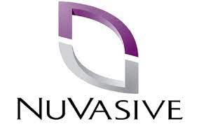
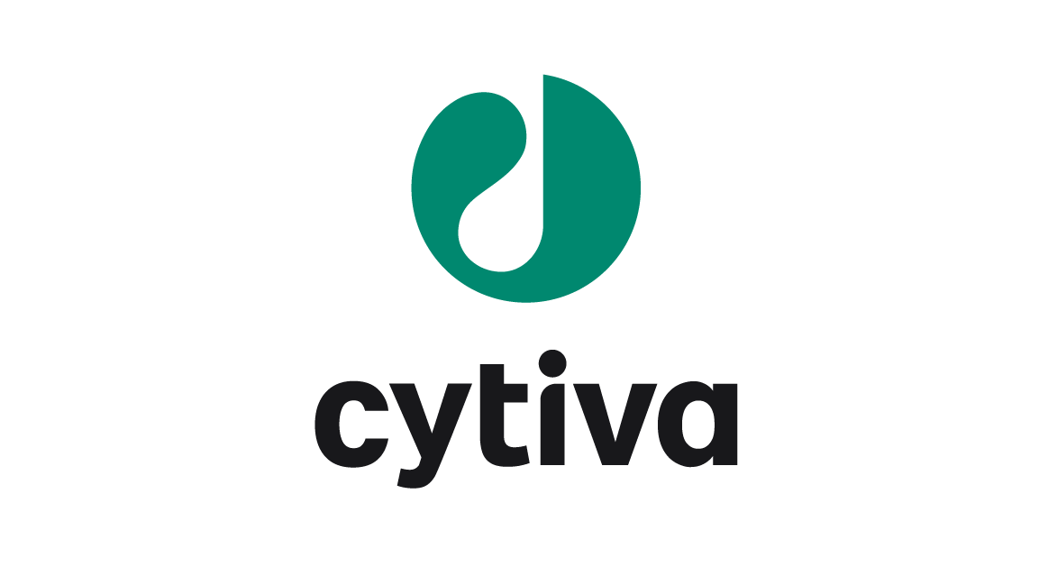
Our Customers
Semiconductor
Medical /Life Sciences
Electronics/Misc

